Slide 1
Signal Operations
Signals and Systems Fall 2020
Prof. Dr. Adnan Kavak
Computer Engineering
Kocaeli University
Textbook: Linear Systems and Signals, B.P. Lathi
This slides are used in EE313 course at the University of Texas at Austin.
They are adopted in this course with Courtesy of Prof. Brian L. Evans

Slide 2
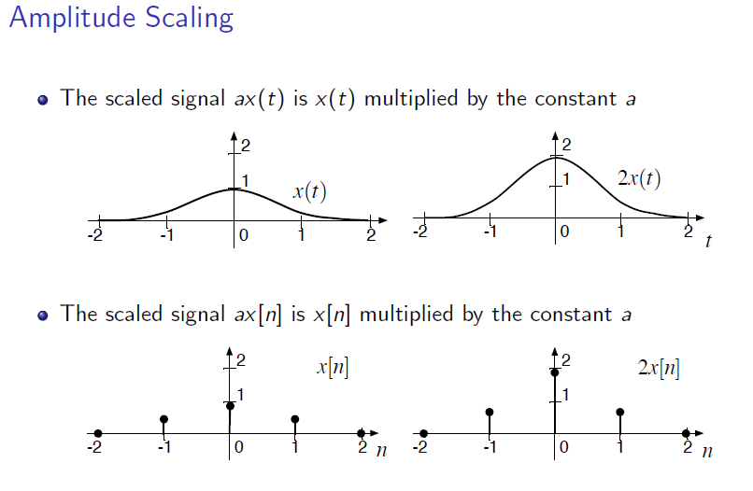
Amplitude Scaling
3 - <number>

Slide 3
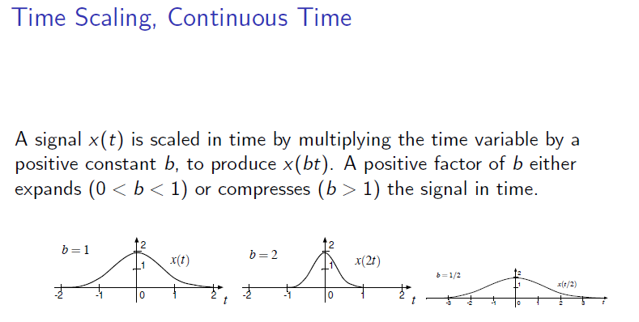
Time Scaling
3 - <number>

Slide 4
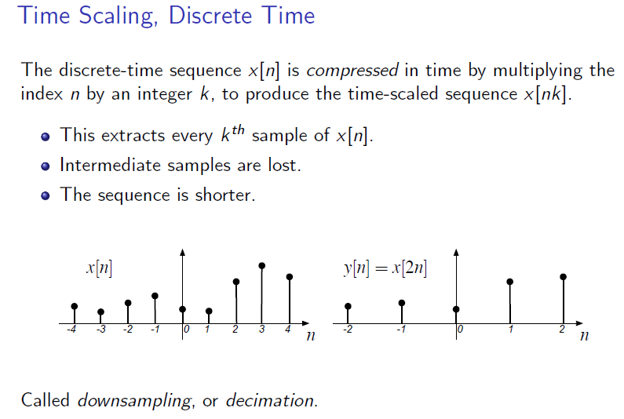
Time Scaling: Compression/downsampling
3 - <number>

Slide 5
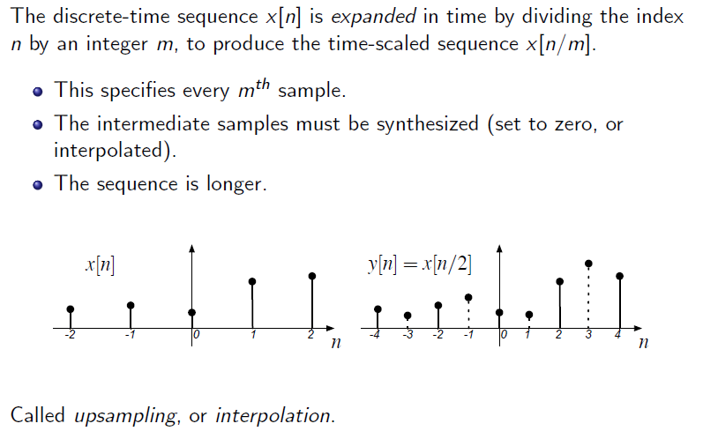
Time Scaling: Expansion/Upsampling
3 - <number>

Slide 6
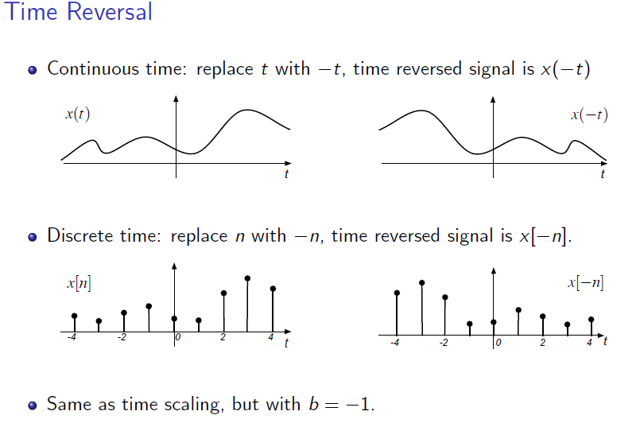
Time Reversal
3 - <number>

Slide 7
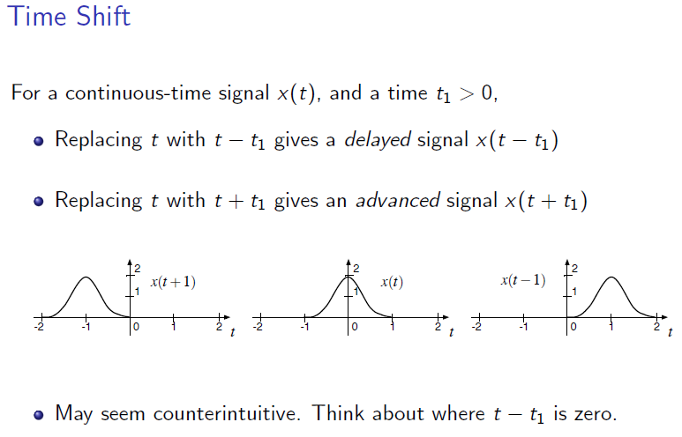
Time Shift
3 - <number>

Slide 8
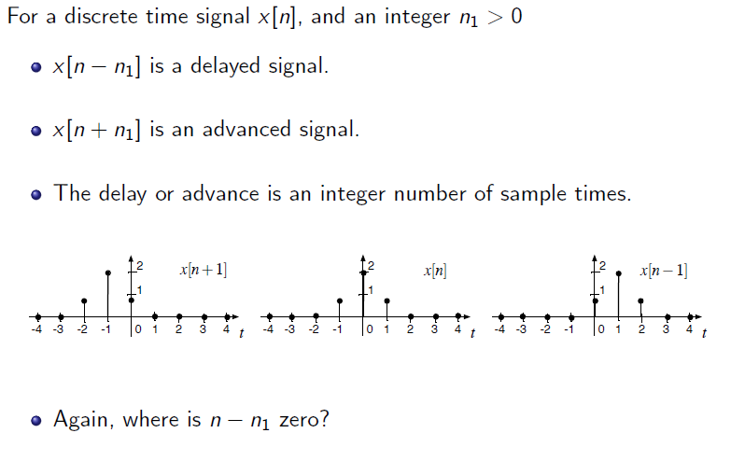
Time Shift
3 - <number>

Slide 9
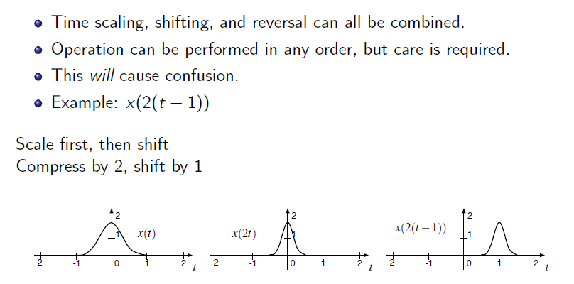
Combinations of Operations
3 - <number>

Slide 10
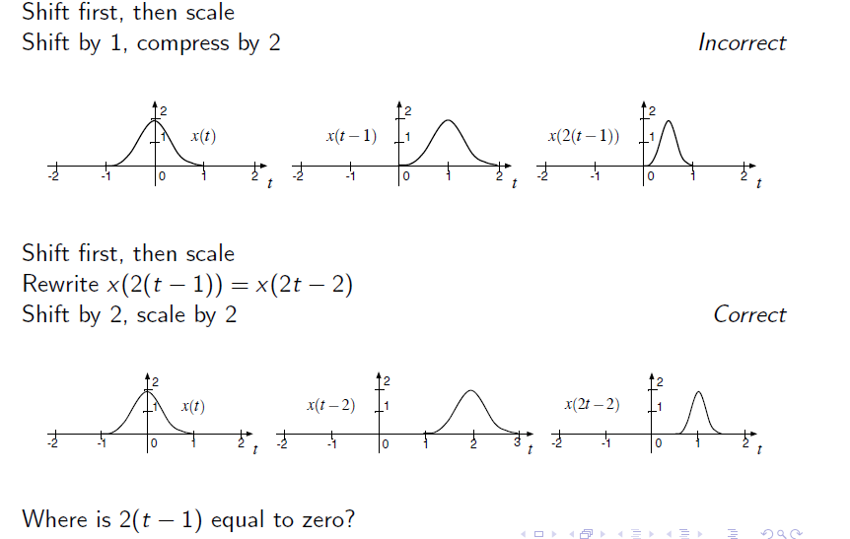
Combinations of Operations
3 - <number>

Slide 11
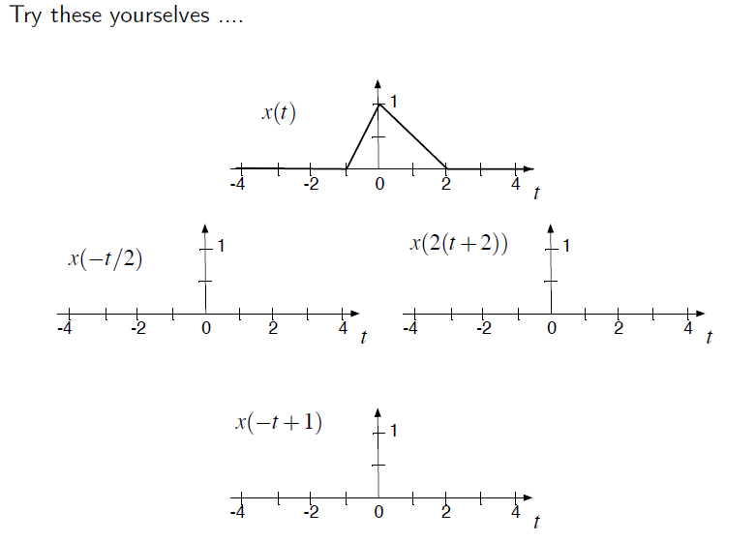
Combinations of Operations
3 - <number>

Slide 12
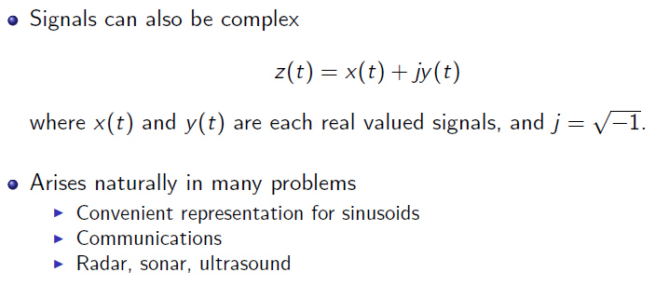
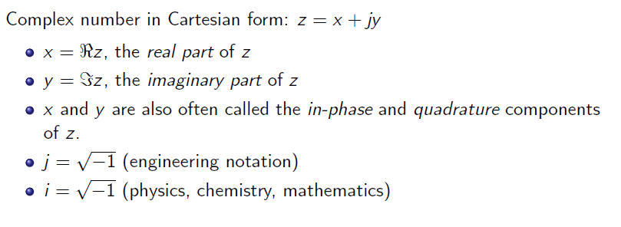
Review of Complex Signals
3 - <number>

Slide 13
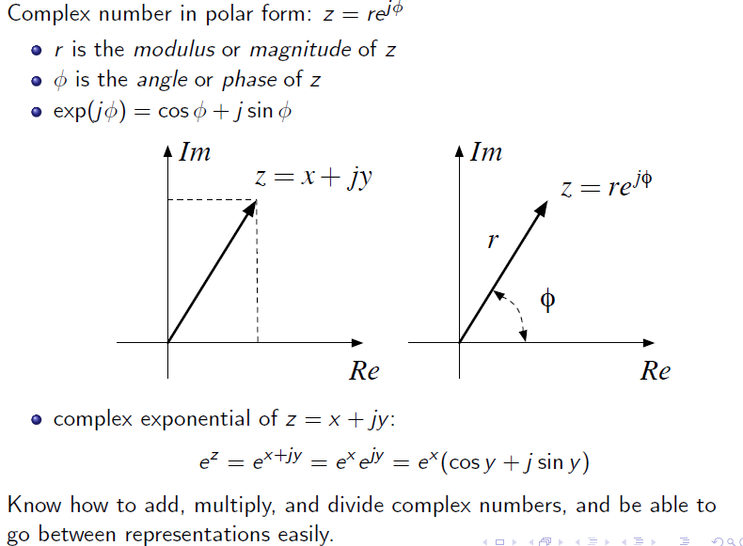
Review of Complex Signals
3 - <number>

